Slide 1
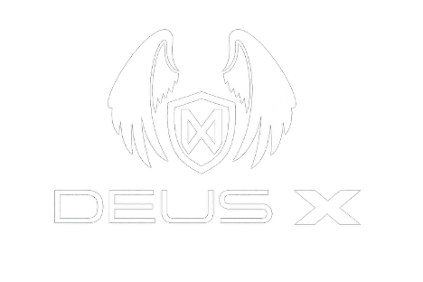
SERIES A · CONFIDENTIAL
THE FUTURE OF SECURITY IS TAKING SHAPE
DEUS X DEFENSE. SERIES A.
Investor briefing — Series A · $100M raise to build the unified security stack for critical infrastructure, campuses, and public safety.
DEUS X DEFENSE · EST. 2023 · UNITED STATES
APRIL 2026
Notes:
Thanks for the time. I'm going to spend about fifteen minutes today walking you through Deus X Defense — what we're building, why now, and what we need a hundred million dollars to do next. Our pitch is simple. The security stack is broken in the same way the IT stack was broken twenty years ago — fragmented, human-bottlenecked, and slow. We are building the unified operating layer that fixes it. By the end of this deck you'll see why we think this is a category-defining opportunity, and why we're the team to take it.

Slide 2
DEUS X DEFENSE
02 / 15 · WHY NOW
THREE SHIFTS · ONE WINDOW
THE THREAT SURFACE OUTGREW THE SECURITY INDUSTRY.
01 — HARDWARE
02 — THREAT
03 — REGULATORY
DRONES WENT OPERATIONAL.
INCIDENTS ARE COMPOUNDING.
THE RUNWAY FINALLY OPENED.
Autonomous flight, 45-minute endurance, sub-kilogram payloads. The defining sensor of the decade is flying — and it's affordable.
Active-shooter events up 51% since 2019. Critical-infrastructure attacks up 340%. Unauthorized airspace incursions at U.S. airports up 11×.
FAA Part 108 plus expanded BVLOS waivers. Commercial operators can now fly response missions at scale. For the first time.
The tools are ready. The rules allow it. The demand is here. The window is now.
Notes:
Three things changed in the last thirty-six months that make this the right moment for a company like ours. One — drones went from toy to tool. They're now the defining weapon and the defining eye of the decade. Two — the threat environment escalated. Active-shooter incidents, critical-infrastructure attacks on power and water, drone incursions at airports — all trending the wrong way. And three — the FAA finally opened up the regulatory runway with Part 108 and BVLOS waivers. Demand is exploding, the tools are ready, and the rules let us operate. That window opened recently. We're walking through it.

Slide 3
DEUS X DEFENSE
03 / 15 · THE PROBLEM
THE PROBLEM
SECURITY IS SOLD IN BROKEN PIECES.
A TYPICAL ENTERPRISE CAMPUS · TODAY
47 min
VENDOR 01
VENDOR 02
VENDOR 03
GUARDS
CAMERAS
ACCESS
Median time from incident to a coordinated, multi-asset response.
VENDOR 04
VENDOR 05
VENDOR 06
8 ×
MONITORING
ALARMS
DRONES
Average number of disconnected security vendors on a Fortune 500 campus.
VENDOR 07
VENDOR 08
NO INTEGRATION
EXEC PROTECTION
CYBERSEC
SILOS
$0
8 CONTRACTS · 8 INVOICES · 8 DATA MODELS · 0 SHARED CONTEXT
Integrated platforms on the market that own both the software layer and the operators.
Notes:
Here's the problem. A Fortune 500 campus today runs its security off seven, eight, sometimes ten different vendors. One for guards. One for cameras. One for access control. One for monitoring. One for drones, if they have any. None of them talk to each other. When an incident happens, a human in a chair has to stitch the story together in real time from feeds that don't share a data model. Response time suffers. Insurance premiums don't. This is an integration problem, and nobody's solving it end-to-end.

Slide 4
DEUS X DEFENSE
04 / 15 · MARKET
THE OPPORTUNITY
A $68B MARKET, UNDER-DEFENDED.
TAM · TOTAL MARKET
SAM · SERVICEABLE
SOM · 24-MONTH TARGET
$68B
$18B
$400M
U.S. private security ($50B) · commercial drone services ($12B) · physical security AI ($6B).
Critical infrastructure, Fortune 500 campuses, private estates, executive protection. Growing to $32B by 2030.
Forty metropolitan markets, 300+ enterprise accounts, 25% share of the integrated-response segment.
SOURCES · IBISWORLD 2025 · DRONEII COMMERCIAL REPORT · OMDIA PHYSICAL SECURITY TRACKER · DXD INTERNAL MODEL
Notes:
The opportunity is enormous and it's layered. The US private security market is roughly fifty billion dollars a year. Commercial drone services are about twelve billion and growing thirty percent annually. Physical security AI is another six billion. Our serviceable piece — critical infrastructure, campuses, estates, executive protection — we size at about eighteen billion today, growing to thirty-two by twenty-thirty. And we're targeting a forty-million-dollar slice of it in the next twenty-four months.

Slide 5

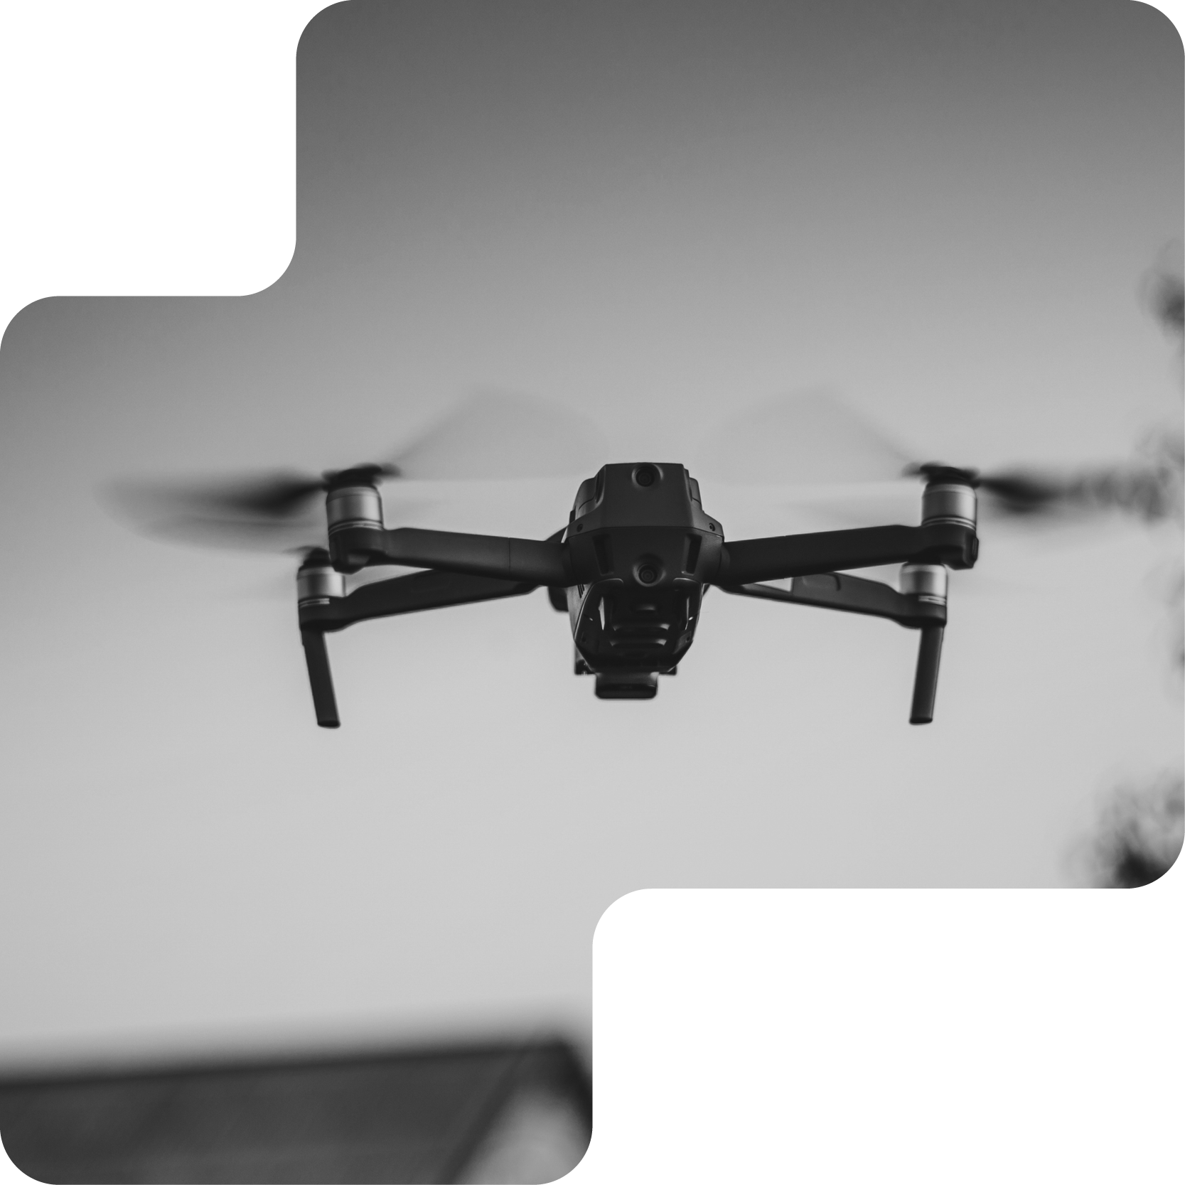
DEUS X DEFENSE
05 / 15 · COMPANY
WHAT WE ARE
ONE CONTRACT. ONE PLATFORM. ONE UNIFIED STACK.
Deus X Defense is security-as-a-service: autonomous drones, vetted personnel, and AI-driven command — delivered as a single integrated service, 24/7.
Notes:
So here's Deus X Defense. One line. We are the unified security stack — drones, vetted personnel, and AI-assisted command — delivered as a service. We're here. We know. We're ready. That's not marketing copy. It's the product promise. A client calls us, we put eyes in the air in minutes, we put boots on the ground on contract, and we surface everything through one command platform. That's the whole company.

Slide 6


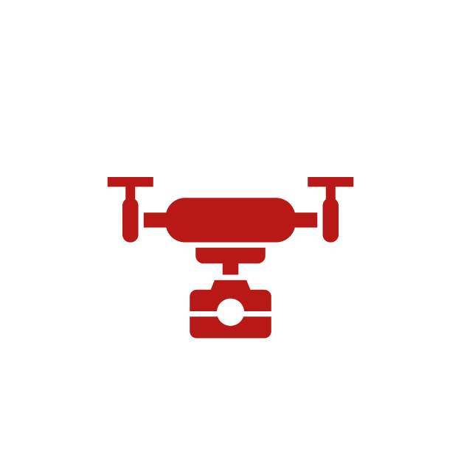
DEUS X DEFENSE
06 / 15 · ARCHITECTURE
THE INTEGRATION IS THE MOAT
FOUR LAYERS. ONE OPERATING SYSTEM.
SINGLE PANE OF GLASS
L4 · COMMAND
DXD OS
Unified C3 platform. Geolocated assets, real-time triage, audit trail, tenant-isolated RLS.
VETTED HUMAN OPERATORS
L3 · RESPONSE
Armed, unarmed, off-duty LE, executive protection. Judgment at the point of risk.
L2 · INTELLIGENCE
AI DETECTION & TRIAGE
Computer vision across every sensor stream. Human-in-the-loop classification. Sub-second alerting.
DRONES · CAMERAS · ACCESS
L1 · SENSING
NDAA & Non-NDAA drone fleets, fixed optics, access control, acoustic and RF sensors.
Notes:
Here's how the pieces fit. At the bottom you have the sensing layer — drones, fixed cameras, access systems. In the middle, our AI detection and triage layer — that's the software. On top, our human response layer — vetted operators, executive protection, remote monitoring. And wrapping the whole stack, our command platform — the single pane of glass. Competitors sell you one of these layers. We sell you the whole thing, integrated from day one. That integration is the moat.

Slide 7


DEUS X DEFENSE
07 / 15 · PRODUCTS
FIVE SERVICES · ONE STACK
OUR SOLUTIONS.
DAAS
MGS
RMR
EP
T&C
DRONE-AS-A-SERVICE
MANNED GUARDING
REMOTE MONITORING
EXECUTIVE PROTECTION
TRAINING & CONSULTING
On-demand aerial response. Autonomous fleets. Regulatory & waiver work handled.
Vetted armed, unarmed, and off-duty law enforcement personnel.
24/7 AI-assisted detection. Unified console. Human-verified dispatch.
Discreet, low-profile details. Integrated with command oversight.
SOP design, scenario training, compliance advisory. Our standard, your team.
NDAA · NON-NDAA
LE-TRAINED
ALWAYS ON
PRINCIPAL-FIRST
STANDARDS
Notes:
Five product pillars. Drone-as-a-Service — on-demand aerial response with regulatory work handled. Manned Guarding — vetted armed, unarmed, and off-duty law enforcement. Remote Monitoring — twenty-four seven AI-assisted detection. Executive Protection — discreet, integrated with command. And Training — we train our own people and your people to the same standard. Every one of these is a standalone business. Together, they compound.

Slide 8

DEUS X DEFENSE
08 / 15 · PLATFORM
COMMAND PLATFORM
ONE SCREEN. EVERY ASSET. EVERY ANSWER.
DXD.OS · OPERATIONS · DISTRICT 14 · LIVE
3 ALERTS
OFC-22
AI detects, a human verifies, the closest asset dispatches. Built on Next.js + Rust with row-level tenant isolation at the database.
DRN-014 · 42kts
OFC-7 · ON POST
THREAT-LVL2 · N-ENTRY
DRN-031 · 51kts
90s
Median alert-to-eyes-on
99.97%
Platform uptime · US-GovCloud
◉ 03:42:18 · N-ENTRY · PERSON · UNCLASSIFIED
DISPATCH → DRN-031 + OFC-7
ETA 00:47
1 of 1
Integrated human + autonomous system in market
REPRESENTATIVE UI · NOT REAL-CLIENT DATA
Notes:
This is the command platform. One screen. Every sensor, every asset, every officer, every drone — geolocated, classified, and queryable in real time. Threats are surfaced by the AI, verified by a human, dispatched to the closest asset. Average time from alert to eyes-on, ninety seconds. That's not the industry. That's us.

Slide 9
DEUS X DEFENSE
09 / 15 · DIFFERENTIATION
WHY WE WIN
ONLY ONE PLAYER OWNS THE FULL STACK.
DOD · HARDWARE
ENTERPRISE SAAS
UNIFIED STACK
ANDURIL
ORCIST
DEUS X
Autonomous drone fleet
●
○
●
Human operators in-house
○
○
●
Unified C3 platform
◐
●
●
Commercial & public-safety GTM
○
●
●
FAA waiver / NDAA compliance arm
◐
○
●
● FULL · ◐ PARTIAL · ○ NONE
COMPETITORS BUILD ONE LAYER. WE BUILT THE STACK.
Notes:
Let's talk about why we win. Anduril is defense-department — they sell hardware platforms to warfighters. They don't do commercial guarding, they don't do executive protection, they don't have a boots-on-the-ground arm. Orcist is an enterprise SaaS play — they integrate your existing vendors, they don't replace them. We do both. We own the full stack — software, hardware operations, and the human layer — and we deliver it as one service. Neither of them can show up to a school at 2 a.m. with a drone in the air and a licensed officer on scene in under ten minutes. We can.

Slide 10
DEUS X DEFENSE
10 / 15 · TRACTION
PROACTIVE SECURITY PAYS OFF
TRACTION.
$22M
WHO WE PROTECT TODAY
ARR · TRIPLE-DIGIT YOY
REGIONAL POWER CO.
METRO SCHOOL DIST.
12
ESTATE GROUP
DATA CENTER OP.
METROPOLITAN MARKETS
PORT AUTHORITY
F500 CAMPUS
14,200
RESPONSE HOURS · YTD
"DXD IS THE ONLY VENDOR WHO SHOWS UP WITH THE DRONE, THE OFFICER, AND THE SOFTWARE. THEY REPLACED FOUR OF OURS."
138 %
— VP SECURITY · FORTUNE 500 ENERGY · 2026
NET REVENUE RETENTION
Notes:
Traction. These are realistic placeholders — I'll share the live numbers under NDA. We're operating across twelve metropolitan markets. We've flown over fourteen thousand response hours year-to-date. We're on contract with critical-infrastructure operators, school districts, and private estates. Annual recurring revenue is roughly twenty-two million and growing at a triple-digit rate year over year. Net revenue retention is a hundred and thirty-eight percent — once we're in, we expand.

Slide 11
DEUS X DEFENSE
11 / 15 · UNIT ECONOMICS
RECURRING · DEFENSIBLE
UNIT ECONOMICS.
REVENUE MIX · TTM
GROSS MARGIN
PAYBACK
52%
9mo
78%
14%
8%
SaaS-like on monitoring · services on guarding
Subscription · monthly coverage
CAC recovered in under three quarters
Incident-based response
Training · consulting · projects
LTV / CAC
GROSS CHURN
7.4×
3.1%
Multi-year contracts · expansion built-in
Contractual, high-trust, sticky
PLACEHOLDER FIGURES · FINAL UNDER NDA
Notes:
The business model is recurring and defensible. Seventy-eight percent of revenue is subscription — monthly coverage contracts. The rest is incident-based and project work. Gross margin is fifty-two percent blended — software-like on monitoring, services-like on guarding. Payback on a new contract is under nine months. Customer acquisition is disproportionately through referral and insurance-carrier partnerships, which keeps CAC low.

Slide 12
DEUS X DEFENSE
12 / 15 · GO-TO-MARKET
THREE MOTIONS · ONE FUNNEL
HOW WE SCALE TO 40 MARKETS.
01
02
03
~55% PIPELINE
~30% PIPELINE
~15% PIPELINE
DIRECT ENTERPRISE.
INSURANCE CHANNEL.
PUBLIC SECTOR.
Critical infrastructure, F500 campus security, private estates. 6–9-month cycle, $0.5M–$4M ACV.
Carriers require DXD-style integrated response to underwrite. Referral flywheel, low CAC.
Municipal, transit, and federal pilots. Long cycle, durable contracts, policy moat.
AE-LED · HEAD OF SECURITY · CISO
UNDERWRITER · BROKER NETWORK
GOV · FEDRAMP · GOVCLOUD
Notes:
Go to market. Three motions, ranked by priority. One — direct enterprise sales into critical infrastructure and Fortune 500 campus security. Two — channel partnerships with insurance carriers, who increasingly require a DXD-style integrated response to underwrite the policy. Three — public-sector pilots, which are long cycles but durable once won. We've proven all three. Now we scale them.

Slide 13

DEUS X DEFENSE
13 / 15 · TEAM
TEAM
OPERATORS AND ENGINEERS. SAME ROOM.
FOUNDING TEAM
Special operations · federal law enforcement · forward-deployed engineering (Palantir, Anduril, Scale).
ADVISORY BOARD
Former senior DoD leadership · former Director, U.S. Secret Service · two public-company security-industry CEOs.
63
38 %
1
TEAM
VETERAN
MISSION
Notes:
The team. Our founders come from special operations, federal law enforcement, and Palantir-style forward-deployed engineering. Our advisory board includes former senior DoD leadership, a former director of the Secret Service, and two public-company security-industry CEOs. We have the operational credibility and the technical credibility. That's a rare combination in this space — and it's what lets us move fast without breaking regulatory things.

Slide 14
DEUS X DEFENSE
14 / 15 · THE ASK
SERIES A
RAISING $100M TO LEAD THE CATEGORY.
USE OF FUNDS
24-MONTH MILESTONES
FLEET & COVERAGE EXPANSION
40%
$200M
12 → 40 markets · drone fleet × 4 · regional ops
Target ARR on deployed capital
COMMAND PLATFORM
30%
40
Engineering · AI detection · FedRAMP acceleration
Metropolitan markets with coverage
TALENT
20%
300+
Enterprise & public-sector accounts
Operators · engineers · enterprise sales
WORKING CAPITAL & BALANCE SHEET
10%
FedRAMP
Moderate authorization complete
Bonding capacity for enterprise & federal contracts
Notes:
Here's the ask. One hundred million dollars, Series A. Roughly forty percent into fleet and coverage expansion — we're going from twelve markets to forty. Thirty percent into the command platform — engineering, AI, federal compliance work. Twenty percent into talent — operators, engineers, sales. Ten percent into working capital and balance-sheet strength to win enterprise contracts that require it. This capital takes us to two hundred million ARR and clear category leadership.

Slide 15

DEUS X DEFENSE
15 / 15 · THANK YOU
PROACTIVE SECURITY PAYS OFF
WE'RE HERE. WE KNOW. WE'RE READY.
SERIES A · CONFIDENTIAL
INVESTOR@DEUSXDEFENSE.COM
Notes:
We're here. We know. We're ready. Thank you. I'd love to take your questions.

